Slide 1
Increasing research visibility & Collaborating across organisational structures
Susanne Mikki

Slide 2
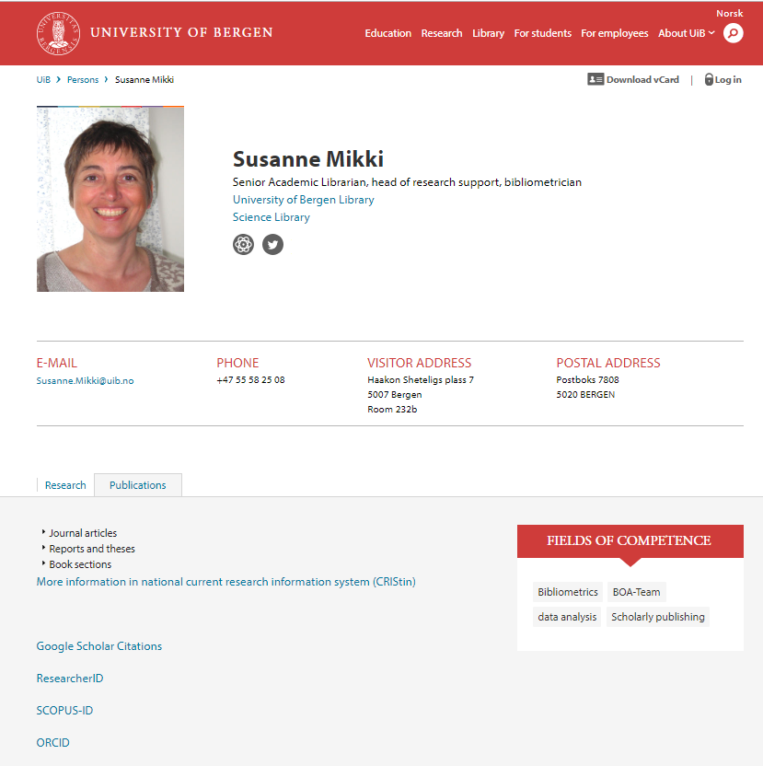
Visibility by publication output

Slide 3
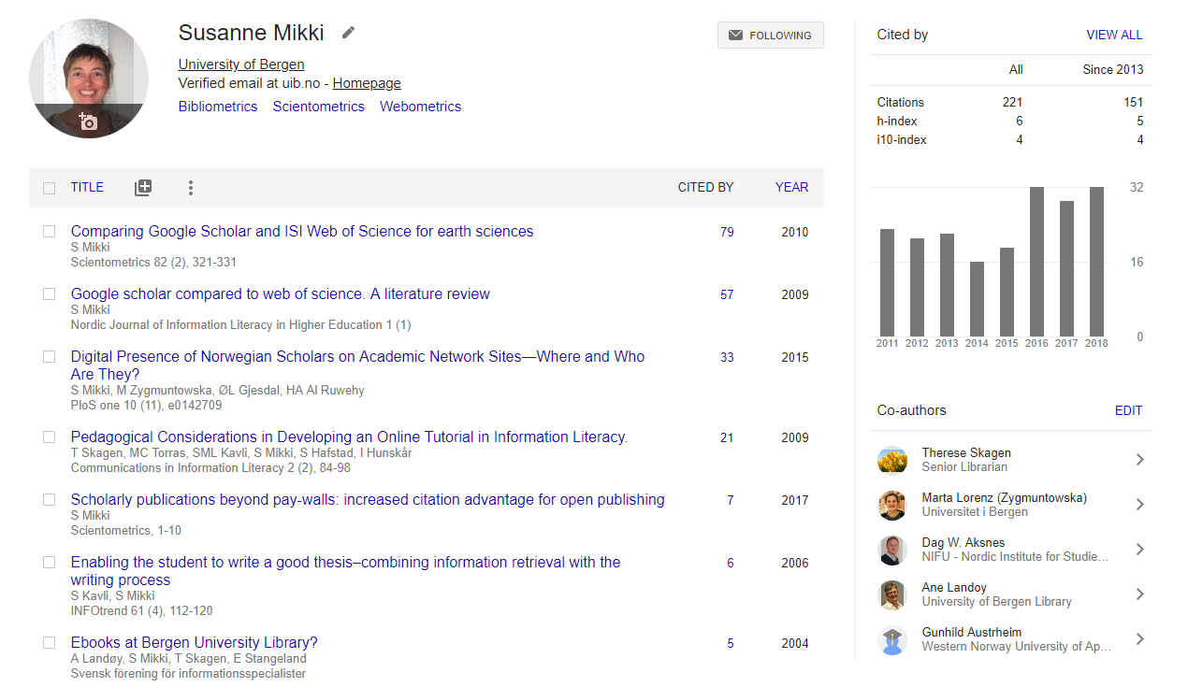
My Google Scholar profile: Publication output and impact
Free of charge

Slide 4
Bibliometric indicators for publishing
Number of publications
per head/year/unit
Number of citations
per publication/head/year/unit
H-indeks (of an author)
Impact factor (of a journal in WoS)
Numbers vary by applied source
WoS, Scopus, Google Scholar
All sources have their own strengths and weaknesses

Slide 5
Impact factor (IF)
IF is a performance indicator of a journal, not an individual researcher
IF represents the mean citation count of a given journal in a given year
The misuse of the IF on individuals has been discussed heavily, and initiatives were taken to avoid unethical use
DORA declaration
Leiden manifesto

Slide 6
H-indeks
The h-index is a popular measure to determine the impact of an individual researcher
A scientist has index h if h of his/her N papers have at least h citations each (Hirsch, 2005).
h varies by database (WoS, Scopus, Google Scholar)
Criticism: Young researchers have a low h
The index can’t exceed the number of publications authored.

Slide 7
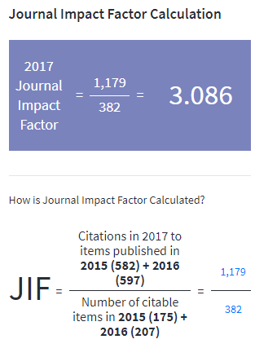

Slide 8
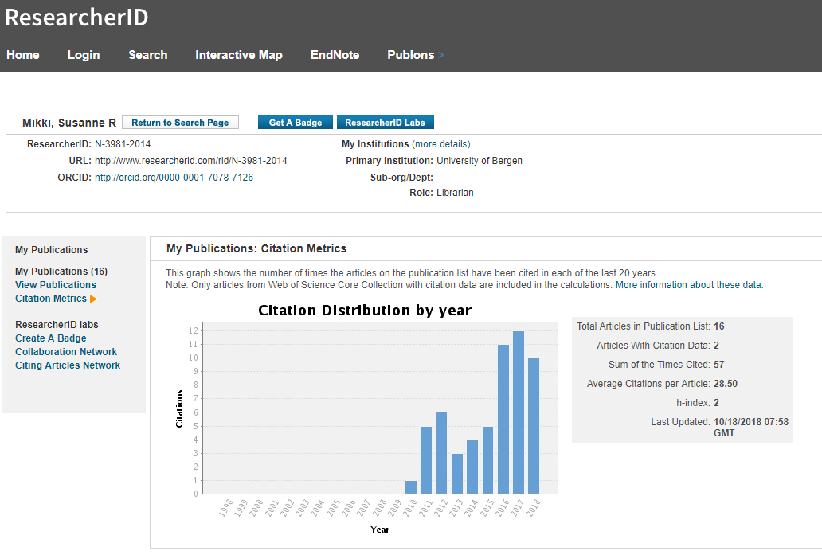
My profile in WoS, h_{WoS}=2 (h_{GS}=6)
Free of charge

Slide 9
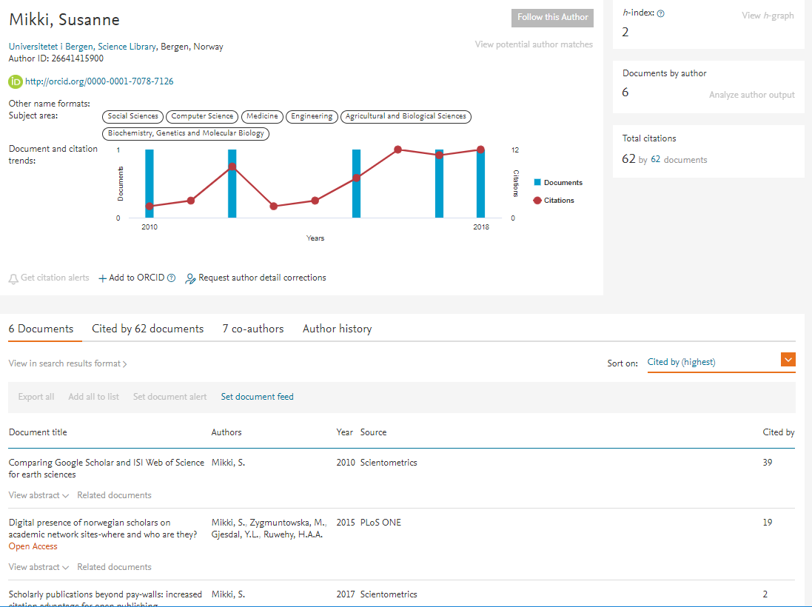
Free of charge

Slide 10
Online profiling services
All services have ‘sleeping’ author IDs, where IDs are created based on carefully assigned algorithms.
Scopus makes these IDs public.
In general, services ask the authors to create, verify and make their profile public.
All published profiles are freely available and easily accessed.
Open profiles add to the principle of open scholarship.

Slide 11
Our study on profiling services
Published at PlosOne an journal ;)

Slide 12
Data sampling and method
Based on all researchers at UiB
Automated harvesting of applied services (including GS, ACA, RG)
Tracking available indicators (number of publications, citations, h-index)

Slide 13
Antall forfattere/profiler i de ulike tjenestene. Unike profiler og dubletter.
 | CRIStin 2010-14 | ORCID | RID | GS | ACA | RG
Retrieved profiles | 4361 | 223 | 154 | 382 | 670 | 2207
Unique profiles | 4307 | 223 | 151 | 378 | 649 | 2120
Duplicates | 54 | 0 | 3 | 4 | 21 | 87
CRIStin authors (%) | - | 108 (48%) | 130 (86%) | 333 (88%) | 169 (26%) | 1307 (62%)
Lav gjenfinning i CRIStin skyldes at profilholder
Er student
Har ikke publisert noe etter 2009
Har oppgitt feil adresse i tjenesten

Slide 14
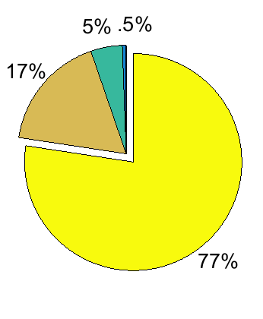
Number of researchers an profile holders
+ 1 researcher with five profiles
4307 publishing researchers (Cristin)
2 profiles
1593 with at least one profile (37%)
1 profile

Slide 15
Visualisering av overlapp mellom tjenestene

Slide 16
Overlap of the largest services
ACA
RG
GS

Slide 17
Use of profiling services by position
Percentages relative to total of researchers within same positon. Highest attendence by Post docs and Professors.

Slide 18
Use of profiling services by gender
43% of authors at UiB are women
Female share lower at the profiling services
Except ResearchGate (RG) 46%. Services with high social involvement attract more likely women.
RG has automated indexing routines, profiles created without permission by profile holder.

Slide 19
Use by faculty

Slide 20
Fleste klarer å vedlikeholde bare en.
Indicators grouped by type

Slide 21
Number of publications in CRIStin
Correlate strongly with number of publications in other systems (except ORCID). ORCID only used for IDs, not publication lists
Correlate weakly with social indicators

Slide 22
Impact indicators correlate strongly with each other within same and across services.

Slide 23
Some thoughts
Services are incomplete and don’t represent the total publication production. Not suitable for evaluational reasons. Careful use only.
Insufficient data quality
IDs are created automatically and recognition may have failed
Profile holders not necessarily verify and update their account. Manipulation may occur.
Social indicators (altmetrics) cannot be use as proxy for traditional metrics. They express something different.

Slide 24
We learned
That in 2014 almost 40% of UiB’s researchers hold å profile. They are used to get visible and contribute to the concept of open scholarship
Services are growing
Services replace some of the traditional library services (discovery tools)

Slide 25
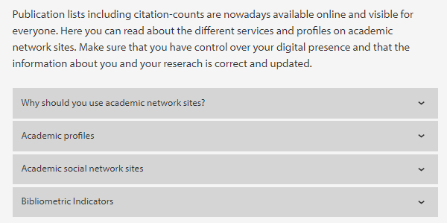
Services provided by the library Research Impact

Slide 26
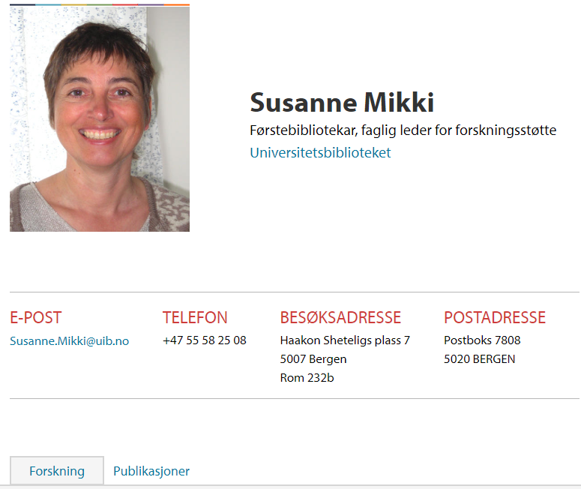
Social involvement
Make your publications visible and accessible
Engage in network
Get an ID/profile to avoid author ambiguity
Get alerted for new publications in your field
Get immidiate attention and feedback for your research

Slide 27
Profiling services - pros and cons
Pros
Having an unique, open identity is part of Open Science
Automatic notifications, stats, and network engagement
Easy and fast to create an account
Cons
Risk of uploading copyrighted material
Commercial providers take over for library services
Insufficient meta data standards and control mechanisms
Easy to manipulate and add false information to increase own impact
Engagement takes time (researchers experience work overload)

Slide 28
Profile doctors
A concept developed in collaboration with the research administration at UiB
Presented at different conferences and events

Slide 29
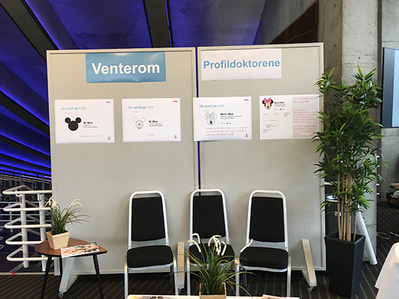
Info screen
Waiting room with magazines
Info flyers
Consultation with profile doctor

Slide 30
1
2

Slide 31
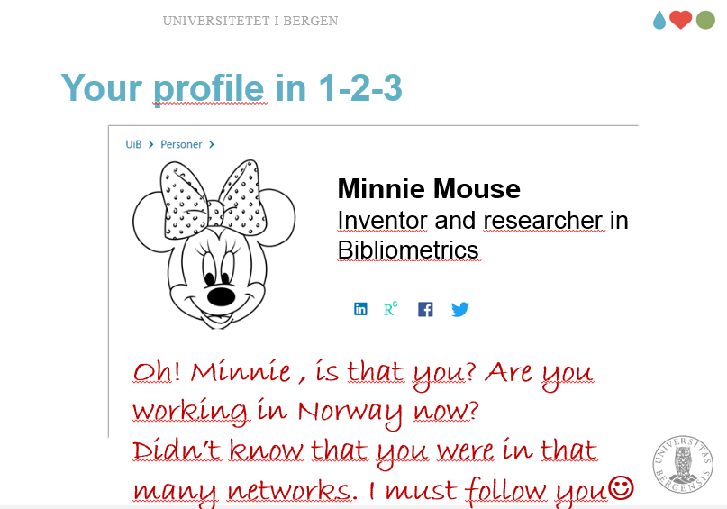
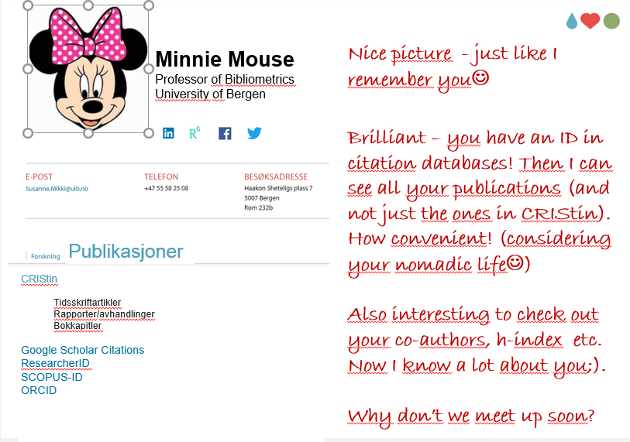
1
2
3
4

Slide 33
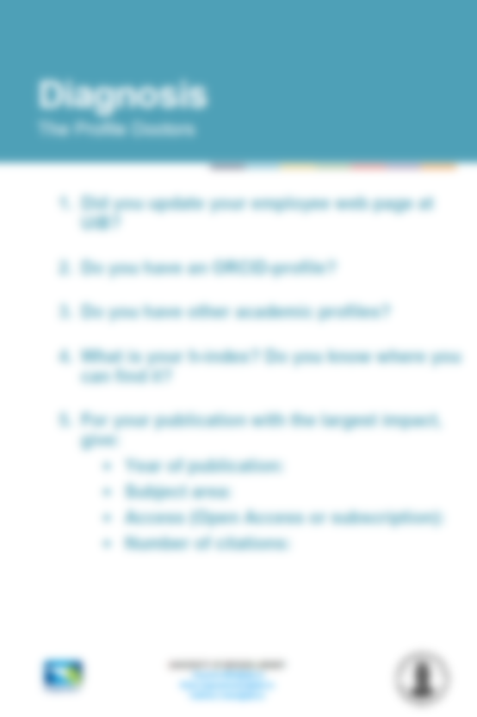

Slide 35
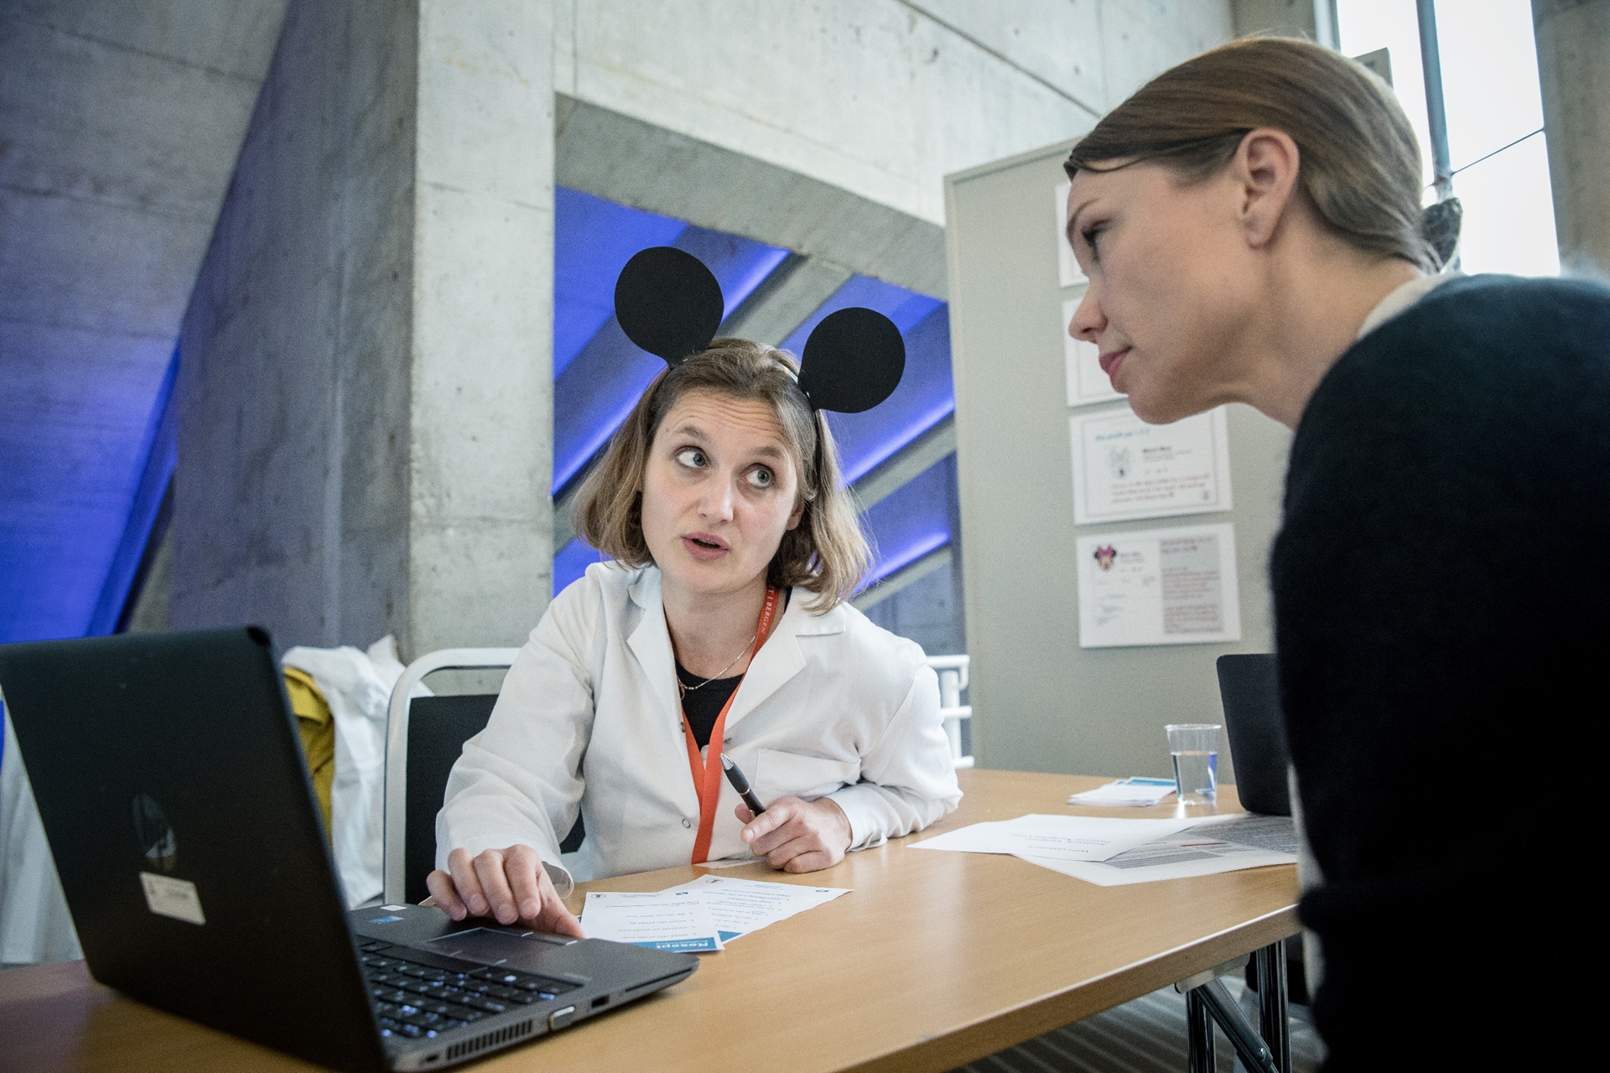

Slide 36
Collaboration across institutional structures
Analytic group at rector’s office
Expert team (BOA) for external funded research
AURORA network for systematic searching and analysing actions in regard to SDGs
Supervising research output to the National CRIS-system (Cristin)

Slide 37
Analytic group
Publication statistics

Slide 38
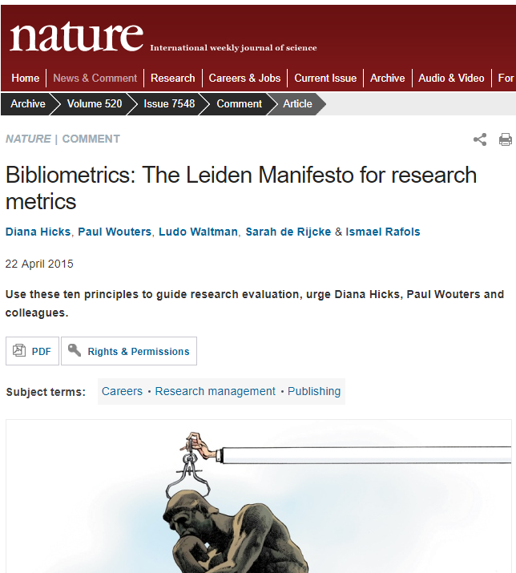
Responsible use of indicators
Ongoing discussion on what bibliometric indicators actually indicate
Initiatives to insure responsible use
Leiden manifesto
DORA declaration

Slide 39
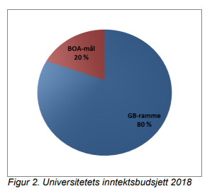
BOA team (externally funded research)
UiB budget, internal and external
The team consists of
Library
Research admin
Human resources
Financial services
Communication division
The team supports project writing and project surveying.

Slide 40
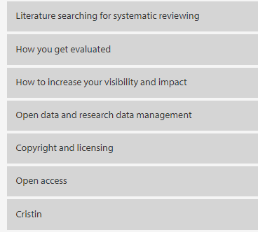
Contribution by the library
Research impact and visibility
Open Access - what, why and how
Data Management Plan
Courses

Slide 41
AURORA network for achieving UN’s SDGs
AURORA is an European initiative to map research output in relation to SDGs
UiB contributes in particular to goal 13 «Climate action»
Benchmarking participating universities

Slide 42
Summing up
Over the last years, the library has developed these novel services
These novel services are highly demanded
We experience, that these service involve different stakeholders inside and outside the library
This challenges traditional workflow and silo-thinking
We try to adapt to new technologies and new workflows
However, things seem to grow big and a feeling of loosing control becomes apparent
Are we sustainable?

