Slide 1
The University of Bergen Open Access mandates
You can write unit / affiliation. leave blank if not applicable. To change content go to: Menu -> Insert (Mac = Display) -> Header and Footer
Ingrid Cutler Academic Liberian
The University of Bergen Library

Slide 2
Outine
The BBB-definition on Open Access (2002, 2003)
The Open Archive (BORA) (2004)
Research Council policy (2009)
1st Open Access policy (2009)
Project for Open Access (2010)
2nd Open Access policy (2012)
Publication fund for Open Access (2013)
National guidelines (2017)
Other examples of mandates from Norway
Open Science at the University of Bergen

Slide 3
The BBB-definition on Open Access
Budapest (2002), Bethesda & Berlin (2003) – established Open Access
To achieve open access to scholarly journal literature, we recommend two complementary strategies:
Self-archiving in repositories
Publish in Open Access journals

Slide 4
Bergen Open Research Archive
Established in 2004 by the University Library
University of Bergen vice-president for research, Rune Nilsen
Norwegian Open Research Archives (NORA) (2004)
Library initiative, support from the Ministry of Education & Research
Unit: Directorate for ICT and joint services

Slide 5
Research Council Policy 2009
The Norwegian Research Council demands that scholarly research articles that they wholly or partly fund have to be made available open access. All articles have to be archived in an open research archive.
Choose Open Access- journals (with funding)
Peer-reviewed version, embargo

Slide 6
UiB Open Access policy 2009
Research available Open Access through open archives
Researchers asked to deliver their peer-reviewed articles to the University within the date of publishing
Peer-reviewed articles should be made available in BORA in agreement with authors and publisher
University Library given the responsibility to inform and facilitate the adaption of the policy

Slide 7
Project for Open Access 2010
Conclusions:
Researchers are positive to Open Access
They do not have the motivation to self-archive - the mandate from 2009 is not something they relate to
Many are more interested in support to publish in Open Access-journals

Slide 8
Open Access policy 2012
Take action towards to other Universities and political authorities to find satisfactory national and international actions for Open Access
The responsibility of the University leadership to follow up

Slide 9
The University asks all employees to make their research publications available open access if possible, either through open research archives and/or through open publishing.
Employees are encouraged to publish their scientific work with publishers that ensure open access, as far as such publishing does not conflict with academic freedom or the University’ goal to publish in reputable publishing channels
Theses and dissertations included in the policy

Slide 10
Open Access fund 2013
Gold and hybrid articles, books
Reduced support for hybrid from 2017
Only lever 2 journals
Budget of 5, 5 million NOK from 2017
What happens after 2019?

Slide 11
National guidelines 2017
Publicly funded research articles are to be made openly available.
Choose open access journals where academically acceptable.

Slide 12
Must be deposited in a suitable academic repository at the latest on the publication date.
Institutions and consortia that negotiate agreements with publishers shall ensure that these agreements promote open access.
Institutions that fund research projects shall contribute to cover the costs associated with open access publishing.

Slide 13
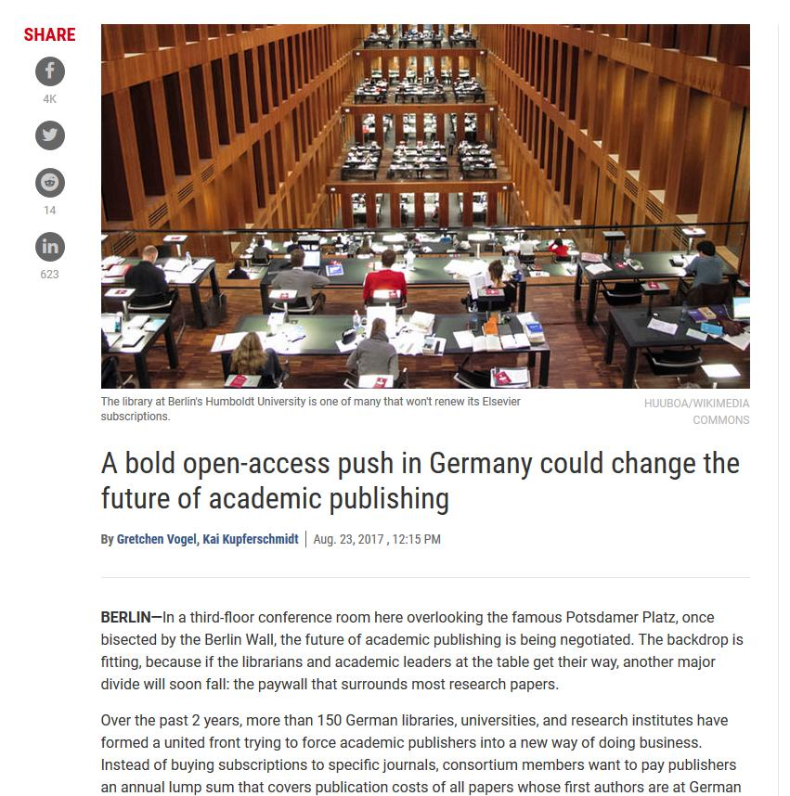

Slide 14
Examples of mandates Norway
NTNU: Stronger policy (publishing policy)
Plan of action towards Open Access
Focus on self-archiving
UiO: Stronger policy
Focus on self-archiving
Follow up of National guidelines

Slide 15
Open Data
Research Council 2014 (2017)
National strategy on access to and sharing of research data (2018)
NTNU: Part of publishing policy (2017)
UiO: Policy and guidelines (2017)
UiT: Policy (2017)
UiB: Working group for research data (2018)

Slide 16
Plan S 2018
“By 2020 scientific publications that result from research funded by public grants provided by participating national and European research councils and funding bodies, must be published in compliant Open Access Journals or on compliant Open Access Platforms.”

Slide 17
Plan S 10 principles
authors should retain copyright on their publications, which must be published under an open license such as Creative Commons;
the members of the coalition should establish robust criteria and requirements for compliant open access journals and platforms;
they should also provide incentives for the creation of compliant open access journals and platforms if they do not yet exist;
publication fees should be covered by the funders or universities, not individual researchers;
such publication fees should be standardized and capped;
universities, research organizations, and libraries should align their policies and strategies;
for books and monographs, the timeline may be extended beyond 2020;
open archives and repositories are acknowledged for their importance;
hybrid open-access journals are not compliant with the key principle;
members of the coalition should monitor and sanction compliance.
Notes:
COAlition S – European Research Council (12 European Countries)
Publish open access within 2020

Slide 18
Open Science at the University of Bergen?

